Slide 1
CHURN PREDICTION
Nikhil S Krishna -23
Sumanth Sanakkayala-22
Tejaswi Ayyadapu-2

Slide 2
INTRODUCTION
Telecom CHURN PREDICTION
Churn prediction is customer defection by predicting which customers are likely to cancel a subscription to a service.
Though originally used within the telecommunications industry, it has become common practice across banks, ISPs, insurance firms.
To analyse customer behaviour,following factors to be analysed
Customer demographic data (age, marital status, etc.)
Sentiment analysis of social media
Customer usage patterns and geographical usage trends
Calling-circle data

Slide 3
DATASET
SCHEMA:
1.State 2.Account length
3.Area code 4.International plan
5.Voice mail plan 6.Number vmail messages
7.Total day minutes 8.Total day calls
9.Total day charge 10.Total eve minutes
11.Total eve call,Total eve charge 12.Total night minutes
13.Total night calls 14.Total night charge
15.Total intl minutes 16.Total intl calls
17.Total intl charge 18.Customer service calls
19.Churn

Slide 4
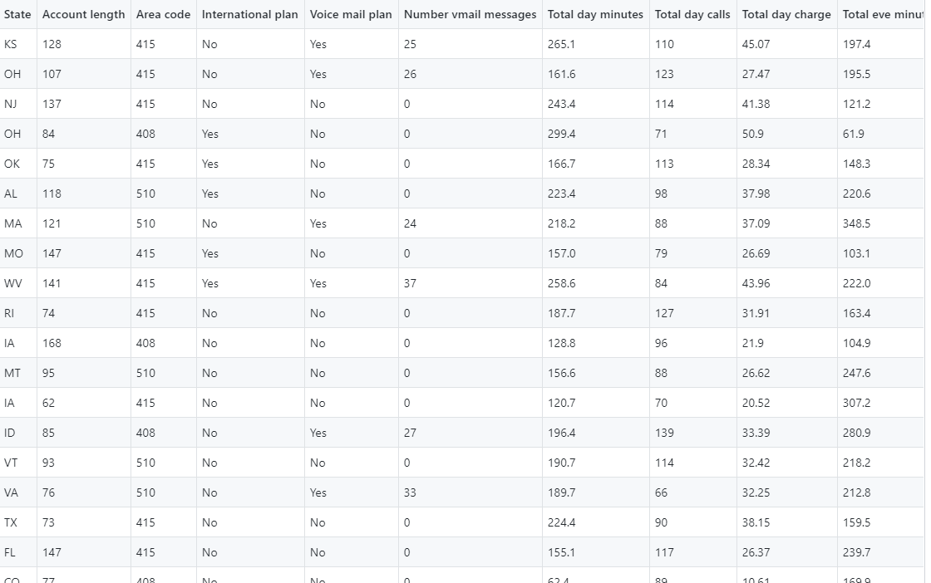
DATASET

Slide 5
PROPOSED SOLUTION
Prediction
Whether a customer has a high probability of unsubscribing from the service or not
Churn is the Label: True or False
Machine learning Algorithms we want to use:
Random forest
Logistic Regression
Decision tree
Comparing The Accuracy of three different Algorithms

Slide 6
Decision tree
A decision tree model is selected because the rules that come out of the decision tree help to understand the root cause of churn better.
The sentiment score is derived from the customer comments text and is an important predictor of churn.
Other important predictors that are identified during the data understanding and modeling phase

Slide 7
CODE(Preprocessing)
Creating schema according to the dataset
Importing training and test data set and making churn attribute as label
Feature engineering
Dropping columns which does not effect churn label

Slide 8
PIPELINE CONSTRUCTION
A Transformer is an abstraction that includes feature transformers and learned models.
Technically, a Transformer implements a method transform(), which converts one DataFrame into another, generally by appending one or more columns.
An Estimator abstracts the concept of a learning algorithm or any algorithm that fits or trains on data. Technically, an Estimator implements a method fit(), which accepts a DataFrame and produces a Model, which is a Transformer.

Slide 9
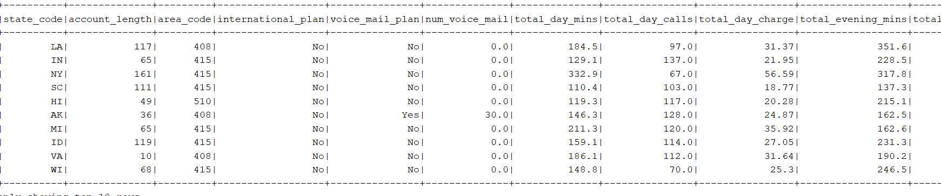
Intermediate results(Top Rows)

Slide 10
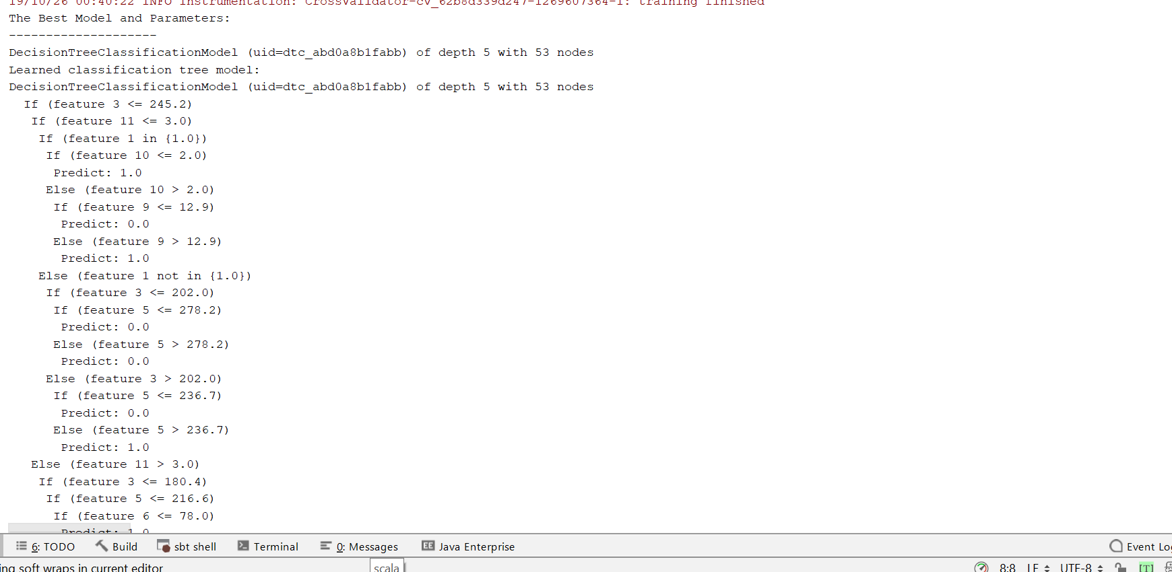
Intermediate Results

Slide 11
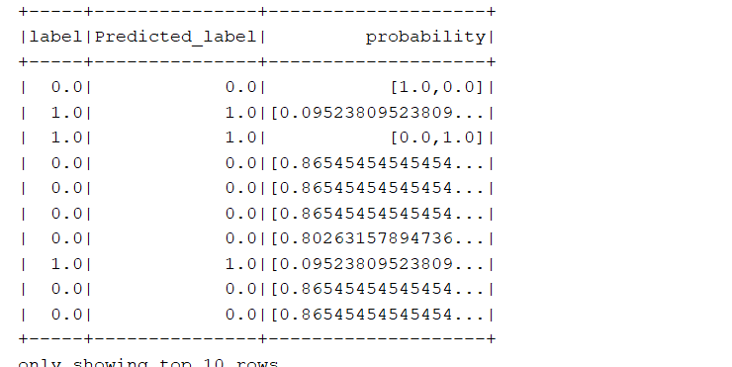
RESULTS

Slide 12
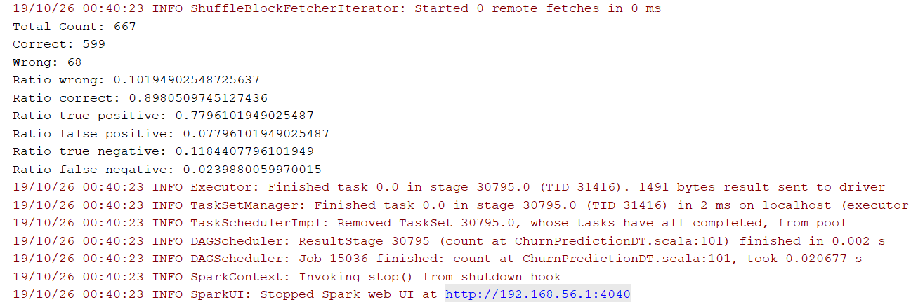
Final Output

Slide 13
Logistic Regression
Logistic regression is a popular method to predict a categorical response. It is a special case of Linear models that predicts the probability of the outcomes

Slide 14
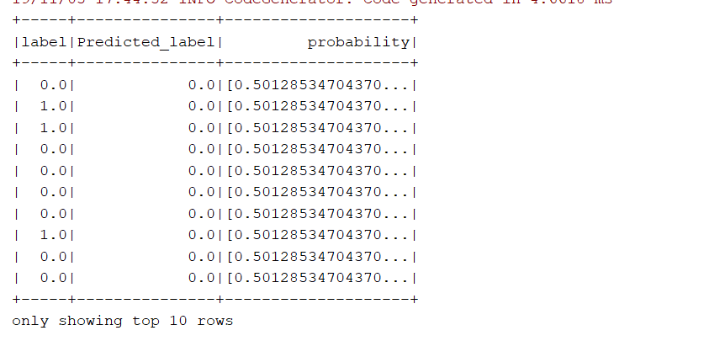

Slide 15
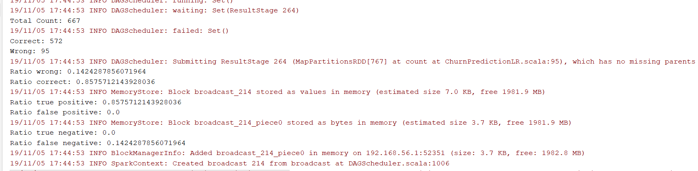

Slide 16
SVM(Support Vector Machines)
A Support Vector Machine (SVM) is a discriminative classifier formally defined by a separating hyperplane. In other words, given labeled training data (supervised learning), the algorithm outputs an optimal hyperplane which categorizes new examples. In two dimentional space this hyperplane is a line dividing a plane in two parts where in each class lay in either side.

Slide 17
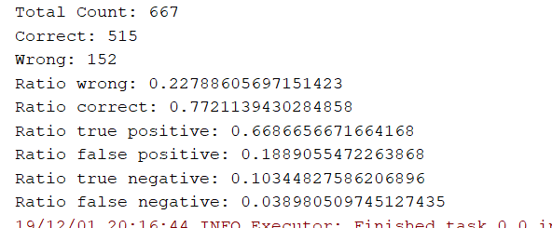
Results:

Slide 18
Accuracy
The Decision Tree has an accuracy of 0.88.
The Logistic Regression method has an accuracy of 0.85.
The SVM model shows an accuracy of 0.91.
Comparing all the three methods, Support Vector Machine gives us the highest accuracy rate.

Slide 19
THANK YOU

